Slide 1
Developing Applications with Spring and
JPA/Hibernate

Slide 2
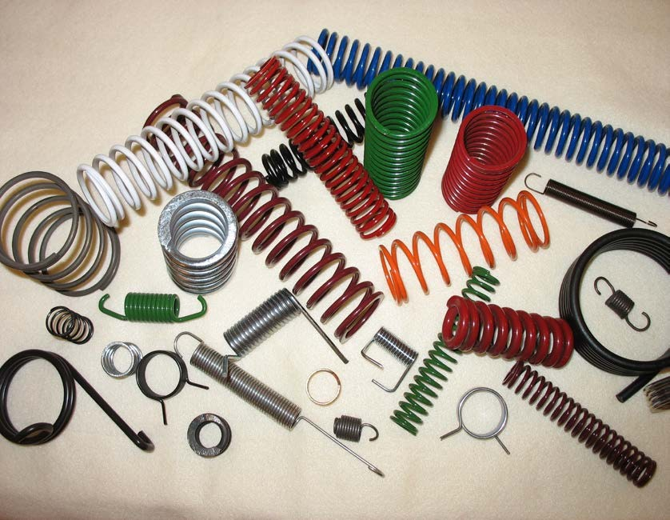
What is Spring?

Slide 3
What is Spring?
A framework originally built to reduce the complexities of Enterprise Java development
POJO based and Interface driven
Very lightweight and unobtrusive compared to older J2EE methodologies
AOP/Proxies
Built around patterns and best practices
Singleton
Factory
Abstract Factory
Template Method
Annotation based configuration

Slide 4
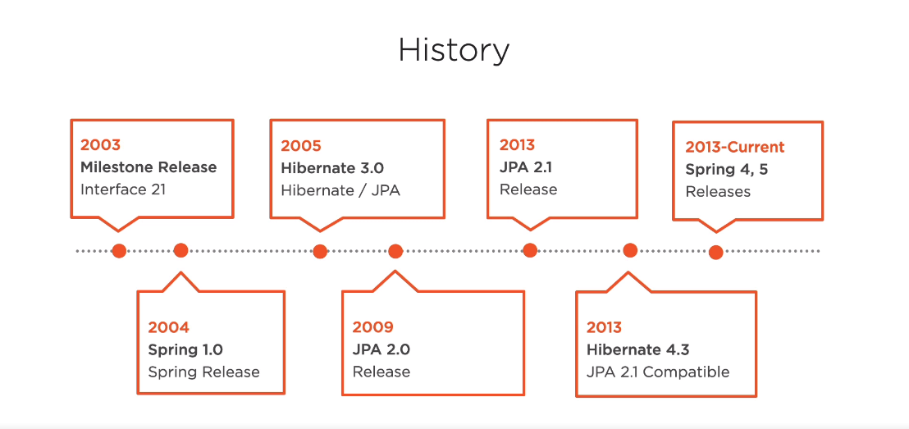

Slide 5
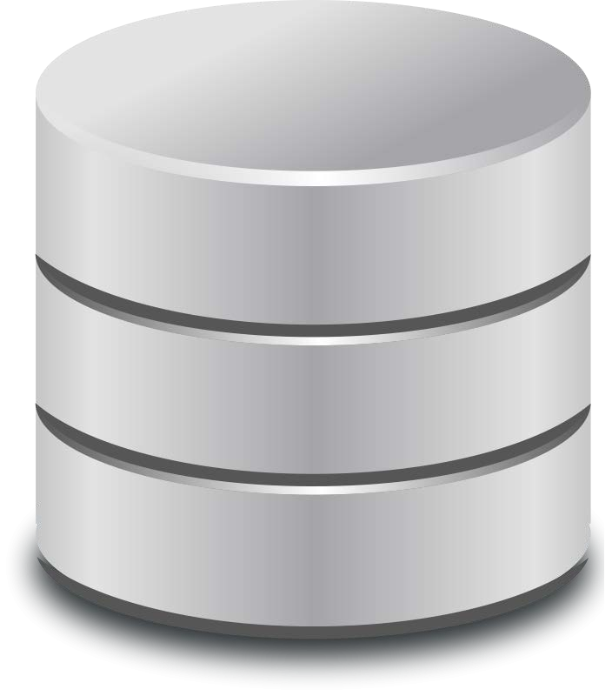
What is JPA?

Slide 6
What is JPA?
Started as Hibernate and then extracted a standard interface
Object Relational Mapping (ORM)
POJO based
XML configuration
Annotation Based Configuration
Built around patterns and best practices
Helps keep your code OO
Pluggable Persistence Providers
Hibernate
Toplink
EclipseLink
OpenJPA

Slide 7
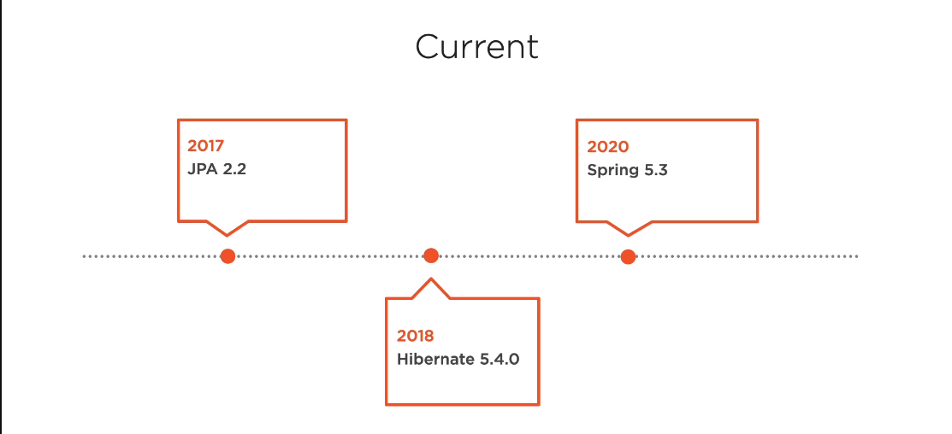

Slide 8
The Problem
Developers don’t always make good DBAs
Data model doesn’t line up with Object model
Configuration is better with JPA, but still could be better…
Transactions
Testing
Datasource configuration
Business Focus

Slide 9
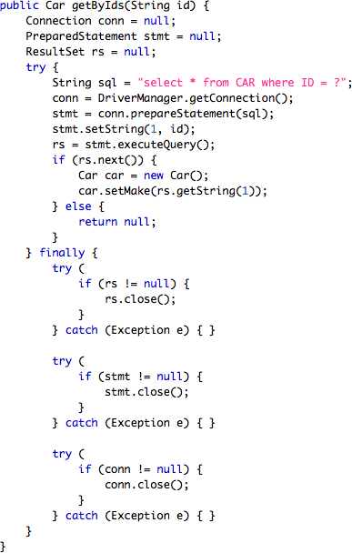


Business Focus

Slide 10

The Solution
JPA removes boiler plate code
Developers build objects, JPA bridges the gap
Spring handles the configuration
Code can focus on testing
Transactions are transparent to the developer
Annotation based development

Slide 11



Business Focus

Slide 12
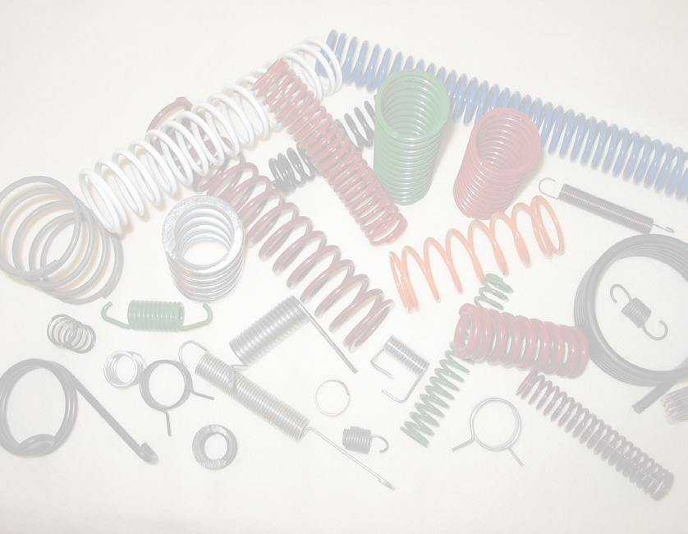
Summary
What is Spring
What is JPA
Business Focus

